Slide 1
Essential Functions for The Clinical Educator: A Contemporary View
Main Speakers: Amy Both, PT, MHS, DCE Julie Crompton, DPT, CCCE Deborah George, PT, PhD, MS, DCE Susan Hartman, PT, MBA, CCCE Corey Overmyer, PT, MSBS, MBA, OCS Jean Weaver, PT, MBA, DCE Friday, October 30, 2015

Slide 2
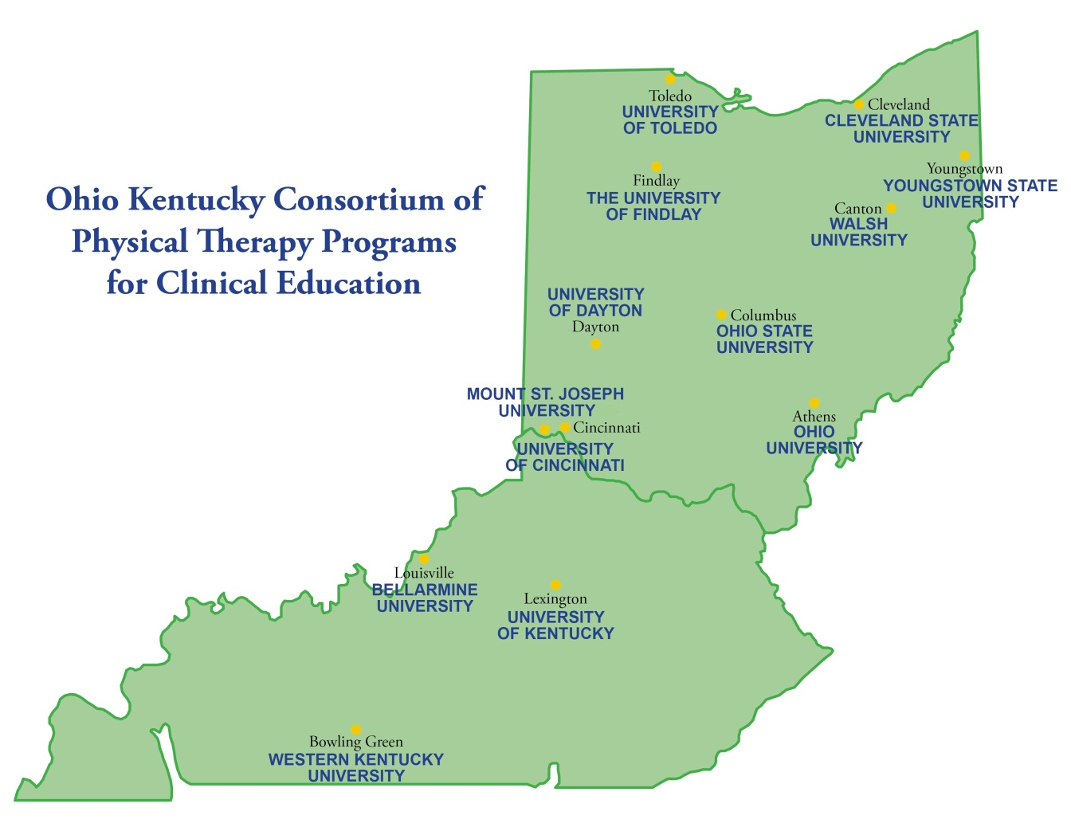
Notes:
Recognize that this course is sponsored by the 13 universities that make up the Ohio Kentucky Consortium of Physical Therapy Programs for Clinical Education

Slide 3
Welcome and Introductions
Bellarmine University - Carrie Clark Hawkins, PT, DPT, OCS &
Beth Quinn, PT, MPT, GCS
Cleveland State University - Karen McIntyre, PT, DPT
Mount St. Joseph University - Jamie Bayliss, PT, MPT
Ohio University - Janice Howman, PT, DPT, Med &
Robert Wayner, PT
The University of Findlay - Jean Weaver, PT, MBA &
Deborah George, PT, MS, PhD
The Ohio State University - Tonya Norris Apke, PT, DPT, OCS, Amelia Siles, PT, DPT, NCS, & Erin Thomas, PT, DPT
Notes:
Welcome to the course, I wanted to take a moment and introduce you to the DCE and Assistant/Associate DCE’s that are present today…

Slide 4
Welcome and Introductions
The University of Toledo - Amy Both, PT, MHS
University of Cincinnati - Chalee Engelhard, PT, EdD, MBA, GCS
University of Dayton - Sean Gallivan, PT, MS, NCS, C/NDT
University of Kentucky - Lynn English, PT, MSEd, DPT &
Kara Lee, PT
Walsh University - Christine McCallum, PT, PhD &
Amy Hassen, PT, DPT, OCS, MTC
Western Kentucky University - Kurt Neelly, PT, PhD
Youngstown State University - Cara Carramusa, MS, PT, GCS

Slide 5
Housekeeping
Breakfast currently being served, please help yourself and enjoy
Lunch will be served at 11:30am
An update on clinical education will be presented during lunch
Restrooms:
To the right of the room at the end of the hallway
Two lefts from the room and down the hallway
Left, slight right down the hallway, and right into the main hallway
Packets with handouts were given out at registration
Notes:
Just a few announcements regarding meals and housekeeping

Slide 6
Essential Functions for The Clinical Educator: A Contemporary View
Main Speakers: Amy Both, PT, MHS, DCE Julie Crompton, DPT, CCCE Deborah George, PT, PhD, MS, DCE Susan Hartman, PT, MBA, CCCE Corey Overmyer, PT, MSBS, MBA, OCS Jean Weaver, PT, MBA, DCE Friday, October 30, 2015
Notes:
Today’s course will focus on…

Slide 7
Course Goals
Differentiate the essential roles and best practices in contemporary mentoring.
Develop CPI based student objectives for use in a comprehensive clinical curriculum.
Use an efficient weekly summary form to enhance communication of student goals.
Summarize the contemporary issues and directives in physical therapy clinical education.
Correctly explain the characteristics of the teachable moment in the clinical setting.
Notes:
The course goals emphasize (read bolded words)

Slide 8
Course Goals
Appropriately apply 3 teaching strategies of questioning, feedback, & reflection to the one minute clinical preceptor technique.
Debate the benefits of contemporary collaborative models of clinical education.
Determine the solutions to the challenges of the 2:1 model of clinical education from both the student and clinical instructor perspective.
Develop ideas for use in advancing site programming/clinical education culture.
Notes:
The course goals emphasize (read bolded words)

Slide 9
Focus of Content
Outcomes Based Learning and Assessment
Teaching and Feedback
Supervision Styles
Administrative Interface
Notes:
You will hear from content speakers on the topics of ..

Slide 10
So let’s get started…

Slide 11
Look Above the Canopy…
New Perspective…
Innovation Seems Possible…
WHAT IF???
Notes:
What if…we took a moment and stepped outside our traditional roles and looked above the canopy…gained some new perspective and had a view that innovation was possible….what if???
Watch video to see reactions to looking above the canopy…it takes work/effort, scary/heights, new perspective, vastness

Slide 12
Is it possible? Can you see yourself?
Innovator
1-4 new ideas to implement following this course
Champion
5 or more new ideas to implement following this course

Slide 13
Essential Functions: Concepts of Contemporary Mentoring
Amy Both, MHS, PT, DCE
University of Toledo
Fall OH- KY Consortium Conference 2015
Notes:
For right now…my role is to introduce concepts of contemporary mentoring into the essential functions of the clinical educator

Slide 14
Objectives
Differentiate the essential roles and best practices in contemporary mentoring.
Definitions and Research
Millennial Considerations
Special Focus on Leadership
Notes:
My objective is to differentiate the essential roles and best practices in contemporary mentoring…. with a focus on clarifying the definitions between a CI and mentor, discussing research related to mentoring, addressing two unique aspects of mentoring: working with millennials and focusing on fostering leadership in students

Slide 15
Are you a mentor?
"Before you are a leader, success is all about growing yourself. When you become a leader success is all about growing others.”
Jack Welch

Slide 16
Definitions (Oxford Dictionary)
Instructor
Mentor
Teacher
Select objectives
Assigned
Value Independence
Advisor
Broadly advise and train
Assigned or Selected
Value Coaching
Notes:
Go through the differences. While teaching and coaching are not mentoring, mentors can teach and coach.

Slide 17
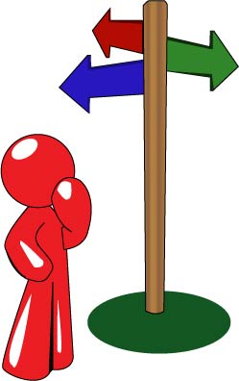
From Clinical Instructor to Clinical Mentor
Vision of the Profession
Identity
Quality (Gwyer, 2015; McCallum et al, 2013)
Collaboration
Natural Progression within our Profession
Credentialing
Mentoring Program
Changes in the Placement Process
Costs
Notes:
Discuss how the vision and the progression in our profession are moving away from an apprenticeship model and moving toward a mentorship model
Identity- recognition, standardization
Quality- The methodological rigor of the available evidence is not high enough to draw definitive conclusions about how quality in physical therapist CE programs should be defined or how it can be measured.
Similar to previous reviews of CE, this study uncovered more questions than it found answers. This systematic review offers a summary of the broad and variable literature that addresses some facets of quality in CE and provides a starting point when determining gaps in the literature.
The development of a research agenda for defining quality in CE would be highly beneficial for directing methodologically rigorous research oriented toward CE best practice for the profession.

Slide 18
Key Roles in Mentoring (Greenfield et al, 2012)
Relationship Building
Communication Skills and Feedback
Clinical Teaching Techniques
Notes:
Greenfield et al 2012: creating a caring environment with students, reflection in practice, incremental learning,

Slide 19
Research
Faculty and Student Perceptions of a Physical Therapy Academic Mentoring Program
Method:
Faculty and students completed electronic questionnaires developed specifically for each group
Results:
Return rate was 54.50% (N=286) for students and 100% (N=18) for faculty
Student response rates:
Effect of the mentoring program on educational experiences, program value, faculty mentor communication all exceeded 90.00%.
Faculty Response Rates:
88.89% agreed their mentees benefited from meeting with them regarding academic issues
94.12% believed the mentoring program was valuable
82.35% thought the program was worth the time spent participating in it
Frese E, Cavallo C, Hawthone K, Kettenbach G, Wilder E, Yemm, B. Faculty and Student Perceptions of a Physical Therapy Academic Mentoring Program. The Internet Journal of Allied Health Sciences and Practice. Oct 2014. Volume 12 Number 4.

Slide 20
Research
Student Perceptions of Outcomes from Participation in Physical Therapy Pro Bono Clinics: A Qualitative Study
Method:
Three focus groups to assess the students' perception of the professional impact of volunteering in a pro bono physical therapy clinic
Results:
Four main themes emerged from the data:
Core Values
Clinical Physical Therapy Skills
Professional Growth
Community and Professional Connections
Conclusion:
The development of a broad range of tangible and less tangible professional characteristics helps to validate student volunteer participation in physical therapy pro bono clinics.
Stickler, Laurie; Grapczynski, Cynthia; Ritch, John. Student perceptions of outcomes from participation in physical therapy pro bono clinics: a qualitative study. Journal of Allied Health, Volume 42, Number 1, Spring 2013, pp. 46-55(10)

Slide 21
Research
Students Mentoring Students in a Service-Learning Clinical Supervision Experience: An Educational Case Report
Method:
Outcomes of the service-learning project were assessed:
Tally of services rendered
Measurement of curricular goal achievement
Survey of the community partners' satisfaction with the event
First-year and third-year DPT student reflection papers.
Results:
The service-learning project was effective in:
Meeting a community need
Enhancing community partner relationships
Fostering student understandings of social responsibility
Creating a valuable peer mentorship experience
Black Lattanzi J, Campbell SL, Dole RL and Palombaro KM. Students Mentoring Students in a Service-Learning Clinical Supervision Experience: An Educational Case Report. Phys Ther. 2011; 1513-1524.

Slide 22
Research
Building Passion Develops Meaningful Mentoring Relationships among Canadian Physiotherapists
Methods:
Participants, involved in receiving and providing mentorship, were interviewed on the impact of mentorship on their careers.
Results:
Participants experienced mentorship as a positive, reflective phenomenon.
According to participants, the true essence of mentorship in physiotherapy consists of:
Building passion
Keeping fresh
Making us stronger
Promoting deeper learning
Conclusions:
Building a shared passion for learning, forms the foundation of meaningful mentorship in physiotherapy.
These mentoring relationships enable physiotherapists to adapt to the changing health care system, advance patient care, and develop the profession.
AM Ezzat, MR Maly. Building passion develops meaningful mentoring relationships among canadian physiotherapists. Physiotherapy Canada. 2012; 64 (1): 77-85.

Slide 23
Two Special Topics
Mentoring and Millennials
Leadership

Slide 24
On Mentoring and Millennials…

Slide 25
Working with Millennials
Personal Characteristics
Research
Optimistic
Tech savvy
Raised with supervision
Collaborators
Socially conscious
Extensive network of communities beyond their employer
Expect to jump in and contribute all they have immediately
A 2012 Bentley study of 1,000 college-educated Millennials found that only 2 percent of respondents claimed that a mentor at work gave them the most career encouragement
33% said spouse/partner
25% said mom
16% said dad
25% gave credit to a manager encouraging them to assume a leadership role at work
Notes:
Some unique considerations regarding millennials…

Slide 26
Mentoring Millennials
Peer Mentoring-key to understanding why 2+ to 1 models can work
Mentoring in reverse-sharing of information from novice to experienced clinicians
Speed Mentoring-emphasis on bursts of information
Notes:
Contemporary concepts that flip our thinking regarding the traditional mentoring process

Slide 27
Ex. Mentoring Program
Mentor and mentee develop a plan for content and experiences to be covered.
Each week the mentee and mentor will cover material that has been pre-outlined information.
The material is a guideline and the pair is encouraged to use this opportunity to discuss:
Pertinent Patient Cases
Anatomy and Biomechanics
Differential Diagnosis
Clinical Reasoning and Research
Treatment techniques
Keep flexibility in the program to allow the mentee and mentor to focus on individual needs.
Notes:
Mentoring can be formal and include program development that fits your clinics operations

Slide 28
On Leadership and Mentoring…

Slide 29
Are you a leader?
“If your actions inspire others to dream more, learn more, do more and become more, you are a leader.”
John Quincy Adams

Slide 30
How will you exemplify leadership to your student(s)?

Slide 31
Personal Assessment: 7 (or 8)Habits of Highly Effective Leaders (Covey, 1990)
Be Proactive
Begin with the End in Mind
Put First Things First
Think Win-Win
Seek First to Understand, Then to be Understood
Synergize-Cooperate
Sharpen the Saw
From Effectiveness to Greatness
Notes:
You might already be familiar with the 7 (now 8) habits of highly effective leaders by Stephen Covey. His work outlines 7 habits or characteristics that are present in highly effective leaders. Of these mindsets, which is your strength or comes naturally to you? Which is most difficult?

Slide 32
Practices of Exemplary Leaders (Kouzes & Posner, 2012; Goleman 2002)
Personal Values
Clear
Set Example by Aligning Actions with Your Values and with Shared Values of Others
Encourage the Heart
Vision
Envision a Future by Imagining Exciting & Ennobling Activities…Have a Plan!
Enlist Others in Common Vision by Appealing to Shared Aspirations
Challenge the Process…Encourage Excellence
Notes:
Consider first having students think about themselves and how their personal views match yours….

Slide 33
Practices of Exemplary Leaders (Kouzes & Posner, 2012; Goleman 2002)
Collaboration, Engagement, and Action
Promote Cooperative Goals & Building Trust
Search for Opportunities by Seeking Innovative Ways to Change, Grow, & Improve
Enable Others to Act
Strengthen Others by Sharing Power and Discretion
Experiment & Take Risks by Constantly Generating Small Wins & Learning from Mistakes
Recognize Contributions by Showing Appreciation for Individual Excellence
Celebrate the Values & Victories
Notes:
Consider first having students think about themselves and how their personal views match yours….

Slide 34
Practices of Exemplary Leaders (Kouzes & Posner, 2012)
Self-Awareness
Social Awareness
Self-Management
Social Skills
Self Confidence
Self Assessment
Empathy
Understanding the Environment
Self-Control
Drive &Motivation
Initiative
Influence
Building Bonds
Teamwork
Notes:
While looking at habits or characteristics is one way of envisioning leadership, another way is to look at broader practices in which leaders engage in when demonstrating effective characteristics.
The work by Kouzes & Posner simplifies the view and narrows the practices to 4 basic processes used when engaged in leadership…which are natural fits for students and how can you increase ways in which they demonstrate these skills?

Slide 35
So how can you as a clinical mentor help a student to develop leadership skills?

Slide 36
Service Learning & Leadership
Participation in Pro Bono Clinics (Black, et al, 2013)
Completion of Service Based Projects (Jackson, 2012 )
Peer to Peer Mentoring (Black, et al, 2011)
Notes:
Background. The physical therapy profession has called for the provision of pro bono services. Little is known about the impact on students involved in sustainable pro bono leadership. One physical therapy program established a pro bono physical therapy clinic under the direct leadership of a board of students. Objective. The purpose of this study was to describe the experiences of the inaugural members of the Chester Community Physical Therapy Clinic Student Board in creating and launching the student-led pro bono physical therapy clinic. Methods. A purposive sample of the 18 members participated in semistructured interviews. Content analysis was conducted using a commercially available software program. Trustworthiness was enhanced with credibility, transferability, and confirmability. Results. The emergent categories were: (1) leadership skill development, (2) competency in hands-on clinical and administrative skills, and (3) commitment to both the community and the clinic. Pride emerged as a strong and overarching theme throughout the experience. Conclusions. The student-led pro bono clinic meets several Commission on Accreditation in Physical Therapy Education criteria in a sustainable manner and serves as a means for measuring and meeting program mission and goals. Participation in the program was a meaningful experience and developed ownership, leadership skills, and pride among the students. There are also possibilities for expanding aspects of the program so that all physical therapist students can benefit from pro bono service opportunities.
The coordination of service learning experiences can play an important role in the leadership development of allied health professionals. Potential allied health professionals can benefit from participation in service learning and co-curricular activities that relate to their curriculum. Peer mentorship can be utilized to facilitate student engagement in co-curricular activities that can assist in the development of leadership skills, technical skills, and other skills required for their profession. The purpose of this article is to identify a leadership model that can be utilized through student organizations in allied health profession education. One model that can be used to facilitate leadership among graduate students is the Social Change Model of Leadership Development. The model encompasses seven domains which include consciousness of self, congruence, commitment, collaboration, common purpose, controversy, and citizenship. This model was used as a framework to facilitate student teamwork and participation within the community.

Slide 37
Conclusion
Move from instructing to mentoring
Be a clinical mentor!
Value the gains that can be made through mentoring
Professional Values and Professionalism
Skill Set Development
Passion for Learning
Peer Mentoring and Milennials
Leadership
Self-Awareness
Self-Management
Social Awareness
Social Skills
7 Habits and Practices of Exemplary Leaders
Service Learning
Keep Leading by Example!

Slide 38
Any Questions??

Slide 39
References
AM Ezzat, MR Maly. Building passion develops meaningful mentoring relationships among canadian physiotherapists. Physiotherapy Canada. 2012; 64 (1): 77-85.
Bentley University, “ Millenials in the Workplace.” 2012. available at: http://www.bentley.edu/centers/center-for-women-and-business/millennials-workplace. Accessed October 25, 2015.
Black, Jill D.; Palombaro, Kerstin M.; Dole, Robin L. Student Experiences in Creating and Launching a Student-Led Physical Therapy Pro Bono Clinic: A Qualitative Investigation. Physical Therapy, May2013; 93(5): 637-648.
Black Lattanzi J, Campbell SL, Dole RL and Palombaro KM. Students Mentoring Students in a Service-Learning Clinical Supervision Experience: An Educational Case Report. Phys Ther. 2011; 1513-1524.
Covey SR. The 7 Habits of Highly Effective People. Franklin Covey Co. 1990.
Frese E, Cavallo C, Hawthone K, Kettenbach G, Wilder E, Yemm, B. Faculty and Student Perceptions of a Physical Therapy Academic Mentoring Program. The Internet Journal of Allied Health Sciences and Practice. Oct 2014. Volume 12 Number 4.
Greenfield B, Bridges P, Hoy S, Metzger R, Obuaya G, and Resukek L. Exploring experienced clinical instructors' experiences in physical therapist clinical education: a phenomenological study. Journal of Physical Therapy Education. 2012; 26 (3): 40-47.
Gwyer J, Hack L. In pursuit of best practice in physical therapy education. Journal of Physical Therapy Education. 2015; 29 (1): 3.
Jackson, Veronica; Service learning and student organization initiatives: facilitating leadership among graduate students.Internet Journal of Allied Health Sciences & Practice, 2012 Jan; 10(1): 4.
McCallum C, Mosher P, Jacobson P, Gallivan S, and Giuffre. Quality in physical therapist clinical education: a systematic review. Phys Ther. 2013; 93: 1298-1311.
Stickler, Laurie; Grapczynski, Cynthia; Ritch, John. Student perceptions of outcomes from participation in physical therapy pro bono clinics: a qualitative study. Journal of Allied Health, Volume 42, Number 1, Spring 2013, pp. 46-55(10).

