Slide 1
EMOTIONAL RESILIENCE
Deborah George, PT, PhD, MS,DCE
Allison Durham, PT, DPT, RN, DCE
Zachary Hughes, PT

Slide 2
Objective
Develop an awareness, strategies, & a supportive approach to mentoring that fosters emotional resilience in students during clinical education.
Notes:
Introduction & present objectives - AD

Slide 3
Evidence on Growth of Mental Health Issues
MILLENIALS: Ages 22 – 37 GEN Z: Ages 15 – 21
American Psychological Association, 2018 ¹
Notes:
AD

Slide 4
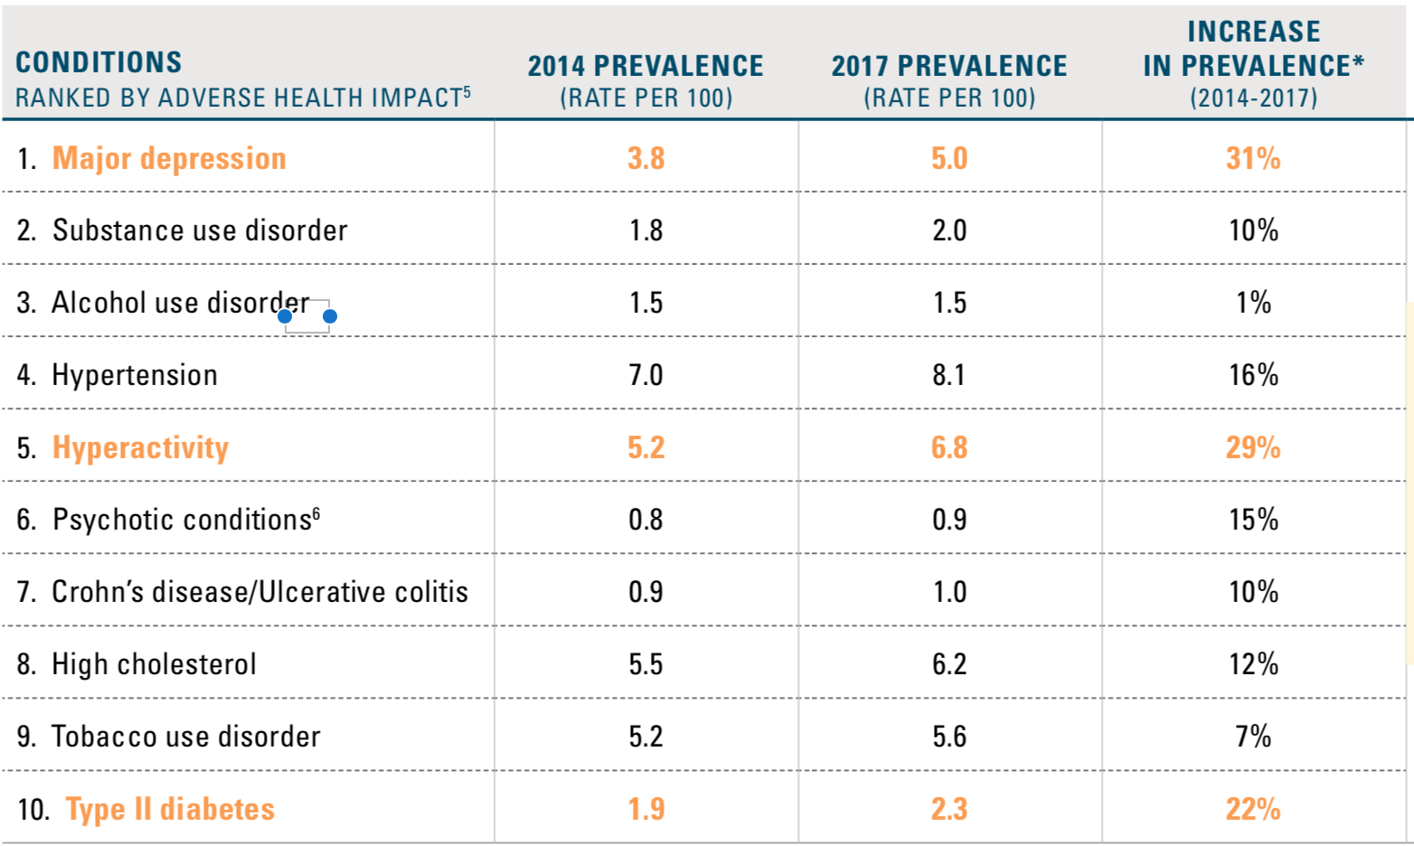
Evidence on Growth of Mental Health Issues
TOP 10 CONDITIONS AFFECTING MILLENNIALS AND PREVALENCE INCREASE
(AGES 21-36 IN 2017)
Blue Cross Blue Shield, The Health of Millenials, 2019 ²
Notes:
AD

Slide 5
Theories to Contribution of Rise in Student Stress
  Social Media/Technology³
    Constantly faced with negative news
    Comparisons decreasing self esteem
    Less human interaction leading to poor development of communication and socialization skills
  “Lawnmower” Parenting⁴
    Parents “mowing down” child’s conflicts and struggles
    Leads to child not developing communication or problem solving skills
  More acknowledgement of mental health awareness and needs⁵
    More students seeking help
    Increase in report of mental health issues
Notes:
AD

Slide 6
Response to Student Stress on the Rise
ACAPT Task Force to Enhance Academic Programs’ Awareness of the Mental Health and Wellness Needs of Students & Future Clinicians
The objectives of the task force:
  Improve baseline understanding of challenges to student and clinician well-being
  Raise the visibility of clinician stress and burnout
  To provide tools, resources and/or programming related to this area including research areas
acapt.org/news⁶
Notes:
AD

Slide 7
Definitions
Anxiety: a basic human emotion, whereby the individual is apprehensive about uncertain outcomes.⁷
State Anxiety: anxiety due to a specific situation & has a trigger.⁷
Trait Anxiety: chronic, pervasive anxiety, not triggered by specific events.⁷
Resilience: the process by which people adapt to changes or crises which is not a character trait, but can be learned.⁸; “the ability to bounce back or cope successfully despite substantial adversity”⁹
Notes:
DG Common language

Slide 8
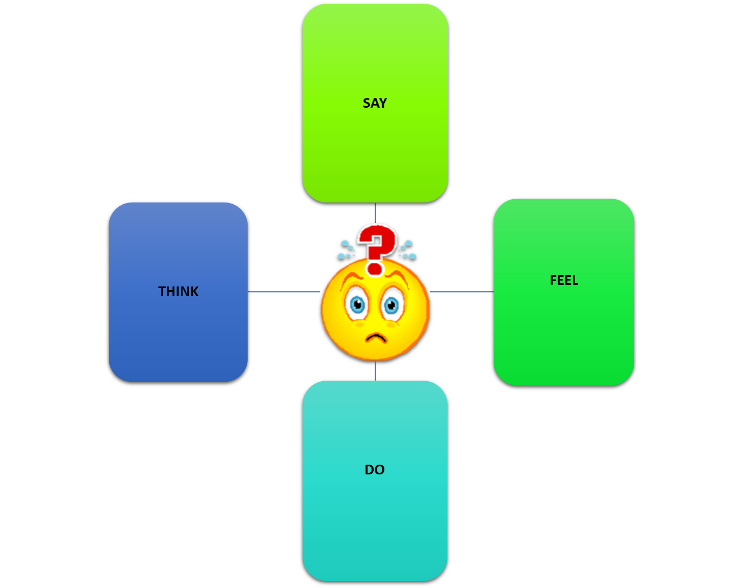
Say Think Feel Do ACTIVITY
SAY
"Ummm"
"I don't know it"
"Not sure"
"What do you think?"
FEEL
Panic
Fear
Uneasiness
Dread
Nausea
THINK
I'm not good enough
I'm stupid
I will FAIL
Mind goes blank
DO
Sweaty hands
S.O.B.
Dry mouth
Big eyes
Muscle tension
Notes:
DG

Slide 9

Student Perspective – Stress Triggers
Notes:
AD

Slide 10
Solution Activity
What could the CI or SCCE do to help alleviate the stress in this particular student?
Notes:
AD

Slide 11
Student Perspective – Potential Solutions
Notes:
AD

Slide 12
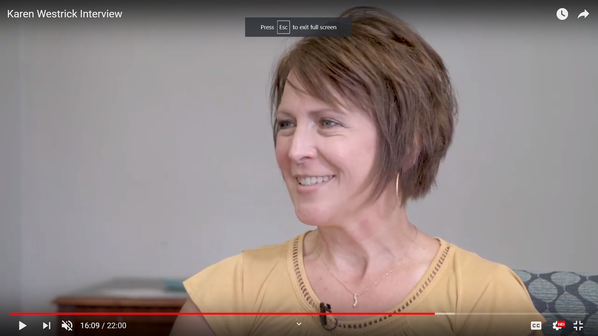
Mental health professional perspective
Videotaped interview of Karyn Westrick
Notes:
BREAK and then DG

Slide 13
Take home message from the expert
Time
Space
Reassurance
Emotional Resilience
Notes:
DG

Slide 14
Emotional Resilience
A dynamic, modifiable process whereby individuals respond to different circumstances with varying degrees of resilience & vulnerability
Antecedents: Challenge, change, &/or disruption are all aspects of adversity
Consequences: effective coping, mastery, and positive adaptation
Earvolino-Ramirez¹⁰

Slide 15
Emotional Resilience
Attributes:
Bouncing back & moving on;
Sense of purpose & achievement in life;
Positive Relationships/Social Support;
Sense of Humor;
Self-Esteem/Self-Efficacy
Earvolino-Ramirez¹⁰
Notes:
DG

Slide 16
Emotional Resilience
Dunn et al.¹¹
Notes:
DG

Slide 17
Strategies for Emotional Resilience
Stress management techniques: mindfulness; journaling; weekly reflections
Self care: meditation; yoga; aerobic exercise; appropriate sleep; good nutrition, avoid caffeine
External support: other students; family & friends
Mental health counseling
Medication
Notes:
DG

Slide 18
Clinical Instructor Perspective
- Zachary Hughes, DPT
A case study of a student with an anxiety disorder
Known Information.
Preconceived Notions.
Boundaries/Expectations.
Feedback Methods.
Emotional Resilience.
Notes:
ZH. Hello everyone, I am please to be here representing our profession and the I feel that these topics are important for both the students and clinical instructors, and will help to guide the clinical education process for overall successful experiences. I have worked with several students that battle with mental health issues and anxiety that impacted their overall performance levels and delivery of PT assessments, interventions, and clinical decisions. From my experiences, I would like to provide some insights that lead to more successful and constructive experiences in the futures.
The information packet should detail the requirements of the clinical rotation, and any prior outcomes. The information packet should include that students goals, brief details of mental health issues, and the learning contract. As the CI I want to know the outcome from any previous performance issues, and the learn contract. I want to know what the students goals are, and what the learning contract will details in order to structure learning experiences. I would like to be aware of the mental health issues, but I do not want any specific details.
Preconceived Notions. I was made aware of the mental health issues, but was not given any details of incidences that occurred in previous clinical rotations or during curricular work. I feel that if a CI is given specific details, then he or she may develop a bias, or preconceived notion, before the student has the opportunity to develop their own management strategies. Preconceived notions, may lead to a repeat performance, and thus hinder learning.
Boundaries and expectations. I wish that I would have been provided with more details as to what behaviors will the student most likely present with, and what challenges have been an issue in the past. For instance, is it documentation time and what behaviors made that a challenge, was is lack of confidence that resulted in poor clinical decisions. Was it purely anxiety that made verbal communication a difficulty task. Having some details as to the students mental health and performance levels will allow for the establishment of boundaries without having preconceived notions (I plan to give examples of communication boundaries). These boundaries, will then allow for expectations (I plan to list out expectations and goals that pertain to my experiences with the students).
Feedback will reinforce the expectations. I like to work on weekly reflections and weekly goals. I wish I had set boundaries that would have given enough time to thoroughly discuss and provide feedback in a summative nature. The feedback would then allow for weekly expectations and ways to better manage the mental health issues.
Emotional Resilience. Our role as the CI is not only to guide the student, and develop learning opportunities, but teach them to be a well rounded clinician. I tried to provide open discussions, and detail that life outside of the clinic is just as important and being a high skilled clinician. (I plan to details some specifics of our discussions).

Slide 19
Brainstorm
What Strategies can you use to promote emotional resilience ?
Notes:
ZH: Introduce the task, and ask the groups to develop some strategies that will help the student to better manage their mental health issues. Meaning, what can we as CI’s do to help the student have less stress, anxiety, and work within the mental health issue for high levels of performance?

Slide 20
Strategies for the Clinical Instructor
Open communication with all parties; humor
Be aware of nonverbals; delivery of feedback
Allow independence, as much as possible
Appreciate learning style & modify teaching techniques
Emphasize positive reinforcement; avoid drilling
Set up conditions for learning (i.e., provide cases)
Use pre-task rehearsal, imagery
Allow extra time for processing
Modify tasks into smaller parts
Provide a break for “melt-downs”
Promotion of team building
Notes:
ZH
Open communication with all parties; humor (use humor to ease unsettling situations). Set boundaries with open communication, and all the student to have time for question and feedback, but make sure its at appropriate times. Limit outside of work communication.
Be aware of nonverbals; delivery of feedback. Be open and receptive. Allow the student to feel that you are engaged and will assist as needed. They need to feel that you are an extension of them and thus support their performance.
Allow independence, as much as possible. Allow the student to have preparation time, and develop plans for assessing, and treating the patient. Often allowing the student to take the lead will give them a sense of confidence and thus have better decision making capabilities.
Appreciate learning style & modify teaching techniques. Learn the students mental health issues, and how they best learn. This will allow for avoidance of negative situations, and tailored experiences to allow for growth.
Emphasize positive reinforcement; avoid drilling. Do not ridicule a student, but find a time and place to provide appropriate feedback. Also do not allow the student to fixate on things, and be able to have constructive feedback sessions with clear closure and expectations of future performances.
Set up conditions for learning (i.e., provide cases). Alternative learning methods may be beneficial for the student to work through clinical decisions, and recognition of disease processes with overall limiting on the spot decisions.
Use pre-task rehearsal, imagery. Briefly talk over the plan or strategy before implementing the plan.
Allow extra time for processing. Provided effective time after the student has worked with the patient to either take notes, briefly document, or internally reflect for future performances.
Modify tasks into smaller parts. Allow the student to perform certain portions, while you as the CI complete the remainder. For instance, have the student complete the difficult skills, or do the documentation as you work hands on with the patient.
Provide a break for “melt-downs”. The student will have continues poor performances if time is not allowed for a mental break. This needs to occur with open communication in which the student feel comfortable asking for a break.
Promotion of team building. Facilitate learning opportunities is which the student can observe, work with, and be apart of a group. Allow the student to learn from other expertice. The student may have a connection with another person, and thus have a way to develop emotional resilience.

Slide 21
Student & Clinical Educator’s Responsibilities Chart
Notes:
DG

Slide 22

Summary – We are a team ….
Student
CI
SCCE
DCE/ACCE
Unconditional positive regard
Notes:
DG

Slide 23
Questions ?
Contact information:
Deborah George - 419-434-5531 george@findlay.edu
Allison Durham – 419-434-5975
  durham@findlay.edu
Notes:
DG finishes….

Slide 24
References
American Psychological Association (2018). Stress in America: Generation Z. Stress in AmericaTM Survey.
Blue Cross Blue Shield (2019). The Health of Millenials. The Health of America Report®.
Lepp A, Barkley JE, and Karpinski AC. The relationship between cell phone use, academic performance, anxiety, and Satisfaction with Life in college students. Computers in Human Behavior. 2014. 31: 343-350.
Haller S. Meet the 'lawnmower parent,' the new helicopter parents of 2018. USA Today. September 19, 2018. www.usatoday.com. Accessed July 29, 2019.
Oswalt SE, et al. Trends in college students’ mental health diagnoses and utilization of services, 2009–2015. J Am Coll Health, 2018; 25:1-11.
American Council of Academic Physical Therapy. https://acapt.org/news. Accessed June 18, 2019.
Hurberty T. Test and performance anxiety. Principal Leadership. 2009; 9:12-16.
Call JA. Resilience in the face of rough times. Psychology Today. July 9, 2008. http://www.psychologytoday.com. Accessed June 26, 2019.
Rutter M. Resilience in the face of adversity: Protective factors and resistance to psychiatric disorder. British Journal of Psychiatry, 1985; 147:598–611.
Earvolino-Ramirez M. Resilience: A concept analysis. Nursing Forum, 2007; 42(2): 73-82.
Dunn L., Iglewicz A., Moutier C. A conceptual model of medical student well-being: Promoting resilience and preventing burnout. Academic Psychiatry, 2008; 32: 44–53.

