Slide 1
Administrator’s View of Program Development
Corey Overmyer, PT, OCS, CSCS, MBA
Director of Therapy Services
University of Toledo Medical Center

Slide 2
Learning Objectives
Discuss the available literature addressing the perceived barriers to clinical education to include the student’s impact to clinician productivity.
Describe value added benefits of a clinical education partnership in a value based delivery model.
Implement the use of a ‘Balanced Scorecard’ concept in a value based delivery model.

Slide 3
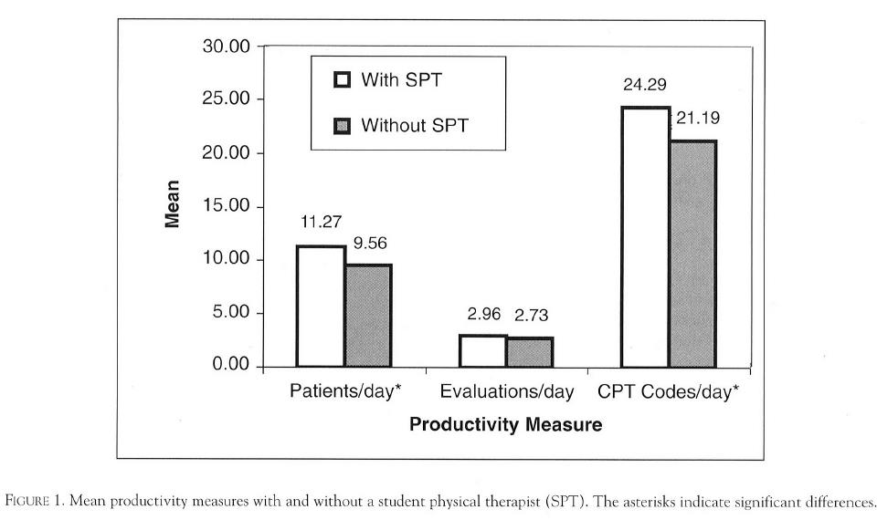
Literature Review
Dillon et al. (2003). Effect of Student Clinical Experiences on Clinician Productivity. Journal of Allied Health, Volume 32, Number 4.

Slide 4
Literature Review
Ozeile et al. (2015). Supervision of Occupational Therapy Level II Fieldwork Students: Impact on and Predictors of Clinician Productivity. The American Journal of Occupational Therapy, January/February 2015, Volume 69, Number 1.

Slide 5
Literature Review
Ladyshewskyet al. (1998). A comparison of productivity and learning outcome in individual and cooperative physical therapy clinical education models. Physical Therapy Journal, 78: 1288-1301.
Ladyshewsky(1995). Enhancing Service Productivity in Acute Care Inpatient Settings Using a Collaborative Clinical Education Model. Physical Therapy Journal, 78: 53-60.

Slide 6
Value Added Benefits of a Clinical Education Partnership in a Value Based Delivery Model
A culture of clinical education partnership
Clinical Education
Clinical Practice
Research
Professional Development

Slide 7
Implement The Use of a ‘Balanced Scorecard’ Concept in a Value Based Delivery Model
The Balanced Scorecard Concept
Optimize the balance of clinical, operational, and financial performance.
Volume vs. Value Based Delivery

Slide 8
Questions?

