Slide 1
OKPTCE COVID-19 Clinical Education
The evolving landscape of educating our future PTs during pandemic times.
Sean Gallivan PT, DCE, University of Dayton: sean.gallivan@udayton.edu

Slide 2
CE Pandemic Points of Discussion
What are the latest resources regarding return to clinical education
How are schools preparing students differently for clinicals during Coronavirus times
school-based requirements
clinic-based requirements
What are clinics and schools learning from the first few weeks of resuming clinicals for many clinics/PT programs?
What recommendations do you have or resources do you need based upon these observations/learning points?

Slide 3
CE Pandemic Resources
What are the latest resources regarding return to clinical education –
OKPTCE Ohio Kentucky Consortium of Physical Therapy Programs for Clinical Education
ACAPT American Council of Academic Physical Therapy
CDC Center for Disease Control
CAPTE Commission on the Accreditation of Physical Therapy Education
APTA American Physical Therapy Association
APTE Academy of Physical Therapy Education

Slide 4
OKPTCE: https://www.okptce.com/

Slide 5
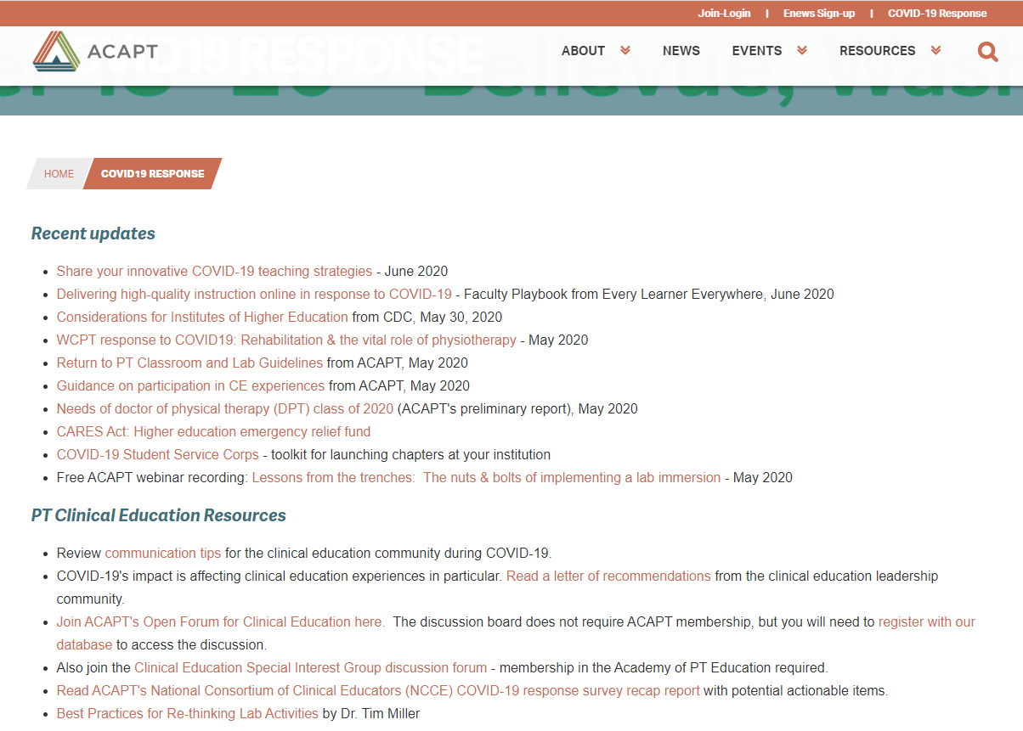
ACAPT: https://acapt.org/covid19-response

Slide 6
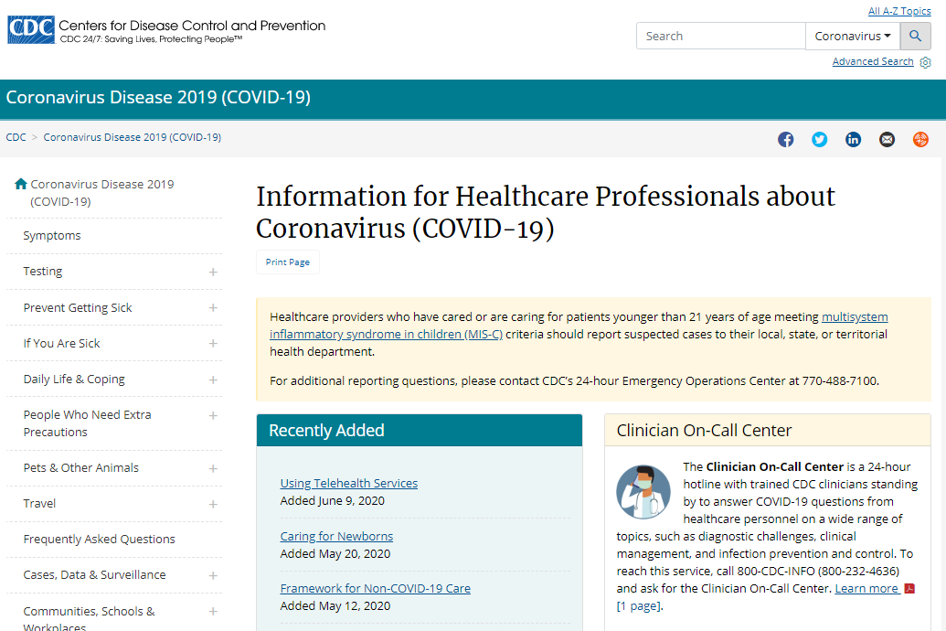
CDC: https://www.cdc.gov/coronavirus/2019-nCoV/hcp/index.html

Slide 7
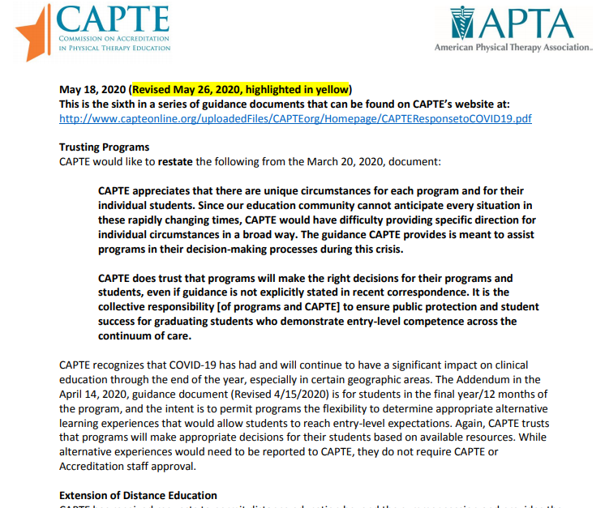
CAPTE: http://www.capteonline.org/uploadedFiles/CAPTEorg/Homepage/CAPTEResponsetoCOVID19.pdf

Slide 8
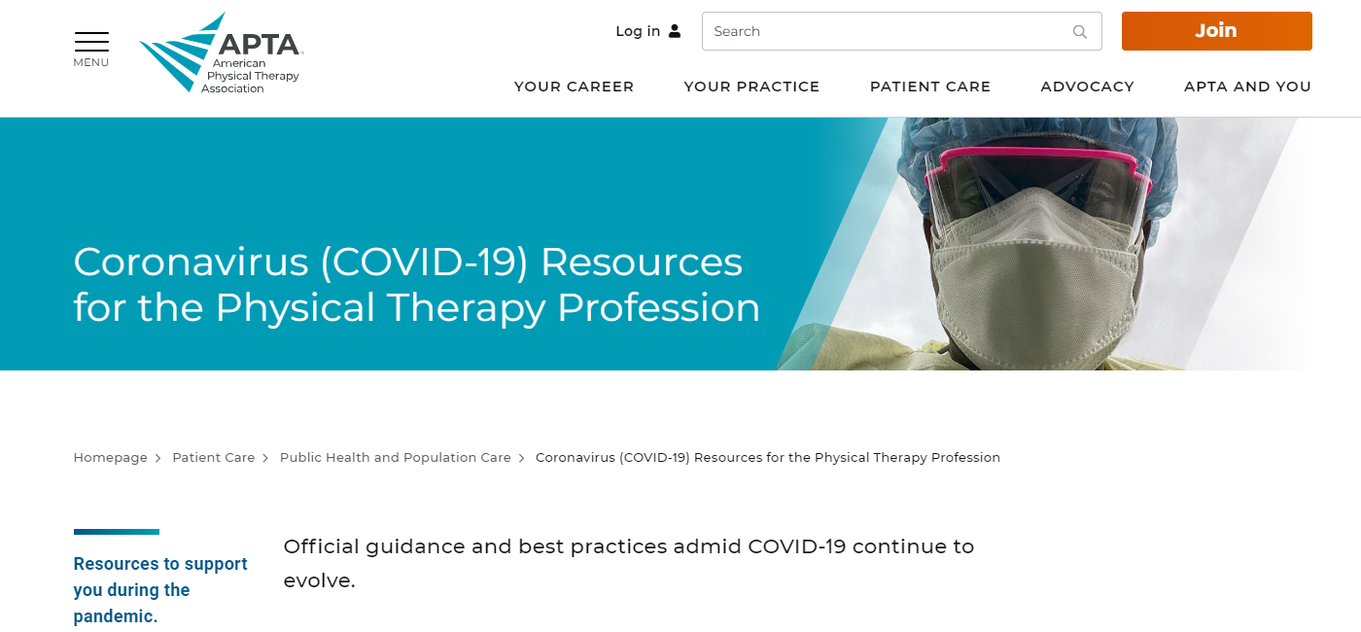
APTA: https://www.apta.org/patient-care/public-health-population-care/coronavirus

Slide 9
APTE: https://aptaeducation.org/members/covid-19-physical-therapy-education.cfm

Slide 10
Student Preparation for Pandemic CE Differently prepared vs. less prepared
Online lecture and labs
On-campus “PT Lab Boot Camp” intensives
Temperature and wellness screens
Pandemic topic education (PPE, Infection Contol, CDC guidelines)
Pandemic Attestation – legal statement on being informed and accepting risk of participation in CE

Slide 11
Tracking Temps, Wellness CastleBranch: https://discover.castlebranch.com/

Slide 12
Clinical Site Onboarding Requirements in Preparation for Pandemic CE
Temperature and wellness tracking
14-day quarantine in locale of clinic
Travel restrictions
Provision of PPE

Slide 13
The first few weeks of Pandemic CE - What’s different?
Overall, from the academic side…not much
Outpatient orthopedic clinical sites – ramping up patient care after pandemic-related closures or decreases in caseloads
Some telehealth
COVID-19 Exposure

Slide 14
Potential Exposure: Risk Assessment and Work Restrictions https://www.cdc.gov/coronavirus/2019-ncov/hcp/guidance-risk-assesment-hcp.html

Slide 15
Options for completion of clinicals post quarantine
Allow for shortened clinical – CAPTE pandemic guidelines may allow for this
Extend clinical by # days missed in clinic if possible for clinic and curriculum
Require additional clinical weeks – up to a full clinical – at a later time when clinical and curricular availability allows

Slide 16
CE Pandemic Points of Discussion
How are schools preparing students differently for clinicals during Coronavirus times
school-based requirements
clinic-based requirements
What are clinics and schools learning from the first few weeks of resuming clinicals for many clinics/PT programs?
What recommendations do you have or resources do you need based upon these observations/learning points?

