Slide 1
Outcome Based Learning Experiences and Assessment
Julie Crompton, PT, DPT, CCCE
Atrium Medical Center
Middletown, OH

Slide 2
Objectives
Develop CPI based student objectives for use in a comprehensive clinical curriculum.
Use an efficient weekly summary form to enhance communication of student goals.

Slide 3
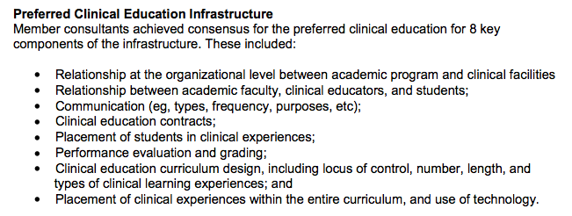
Communication in Clinical Education
Performance standard for new graduates and for clinical instructors

Slide 4
CI performance principles - Communication
What factors may limit achievement?
Lack of preparation and/or use of documents provided by the academic program.
Lack of CCCE preparation and support to ensure that communication moves to the necessary stakeholders involved in clinical education (eg, academic program to ACCE/DCE to the CCCE to CI to student and from student back to CI/CCCE where appropriate and the ACCE/DCE)
Notes:
6. Communication*
The CI will:
1. Communicate in ways congruent with situational needs by adapting communication (verbal, nonverbal, and written) to meet the needs of different audiences.
2. Communicate, expressively and receptively, in a competent manner with patients/clients, family members, caregivers, practitioners, students, interprofessional team members, consumers, payers, and policy makers.
3. Use appropriate professional communication (grammar, syntax, spelling, legibility, and punctuation) in all situations.
4. Demonstrate open, honest, constructive, and assertive communication (verbal, nonverbal and written) with students and others using people-first language.
5. Communicate in a way that demonstrates respect and professionalism.
6. Demonstrate closed-loop communication.
Description of how current environmental factors may limit achievement of the performance principle:
Health Care Facility
Limited time for frequent and consistent communication due to productivity expectations and time constraints.
Variability in communication styles, including use of technology for communication.
Existing tension about degree differentiation (ie, BS vs. MPT vs. DPT).
Lack of preparation and/or use of documents provided by the academic program.
Lack of CCCE preparation and support to ensure that communication moves to the necessary stakeholders involved in clinical education (eg, academic program to ACCE/DCE to the CCCE to CI to student and from student back to CI/CCCE where appropriate and the ACCE/DCE).
Tech Differences in availability of and user’s capabilities for using technology.

Slide 5
Preferred Infrastructure for Clinical Education
Notes:
Preferred infrastructure for clinical education

Slide 6
Levels of Communication
Who?
Institution: student
Institution: CCCE
CCCE: student
CCCE: CI
CI: student
CI: institution

Slide 7
Levels of Communication
Institution: Student
Academic curriculum
Sets the framework for education

Slide 8
Levels of Communication
Institution: CCCE
Partnership for clinical education
Requests for placements
Institution provides information about the student
CCCE provides information about student—CI partnership (for CPI)
Discussion of "problem clinicals“ – critical incident reporting

Slide 9
Levels of Communication
CCCE: Student
CCCE requests information from student; vice versa
Student interview prior
CCCE sends introduction letter, expectations, objectives, CI contact information
CCCE orients the student
Provides clinical education manual

Slide 10
Levels of Communication
CCCE: CI
CCCE acts as liaison between school/student and CI
CCCE and CI discussion of expectations during the rotation
CCCE gathers input from CIs about curriculum and student expectations

Slide 11
Levels of Communication
CI: Student
Set up goals for the clinical rotation
Weekly feedback forms
Other forms of feedback as communication—anecdotal feedback forms, verbal feedback etc

Slide 12
Levels of Communication
CI: Institution
Grading on the CPI evaluation
Red flag issues—clinical learning contract, critical incident reporting
Site visit by DCE

Slide 13
CCCE: Student Manual and Clinical Curriculum
Items to Include:
Information Packet/Introduction Letter
Professional Responsibilities
Learning Opportunities/Downtime Activities
Caseload Expectations
Clinical Objectives—based on CPI performance dimensions
Weekly Feedback Forms
APTA Code of Ethics

Slide 14
CCCE: Student Manual and Clinical Curriculum
Items to Include:
Supervision Laws/Medicare guidelines
Learning Styles Assessment
Hospital Policies
CPI quick references
Clinical Instructor Information Sheet
EPIC quick reference (EMR)
Critical Incident Report and Negotiated Learning Contract

