Slide 1
State of Clinical Education - Transformation
Fall 2015

Slide 2
Learning Objectives
Following this update, participants will be able to:
Identify key stakeholders involved in shaping in clinical education transformation
Understand their current roles in the transformative process
Differentiate priorities currently identified to address from other concerns
Discuss current initiatives in clinical education at the national, state/regional, and local level
Begin to identify your role/the role of your facility in the unfolding transformative process

Slide 3
Collaborating Organizations and Stakeholders
National
APTA
APTA-Education Section
Education Section Clinical Education Special Interest Group*
American Council of Academic Physical Therapy (ACAPT)
National Consortium of Clinical Educators*
(Commission on Accreditation of Physical Therapist Education)
State/Regional
Ohio-Kentucky Consortium of Physical Therapy Programs for Clinical Education*
State Physical Therapy Associations-OPTA and KPTA
Programs and Academic Stakeholders
Programmatic Advisory Groups
DCE’s
Students
Clinical Stakeholders
Clinical Faculty (CCCE’s and CI’s/Clinical Mentors)

Slide 4
APTA
Multiple Roles:
Represents physical therapists and their practice- Board of Directors, Sections, House of Delegates
National and state levels, sections, and SIG’s
Vision, mission, and directives
Career development and lifelong learning
Advocates on issues related to policy and reimbursement
Communicates shared concerns to other organizations and within the organization
Educates the general public
Education Section (See also CAPTE)
Clinical Education Special Interest Group
Links Academic Faculty and Clinical Faculty together

Slide 5
APTA-Education Section – Clin Ed SIG
Links PT and PTA programs and clinicians/clinical faculty together
March Mailing Date

Slide 6
KPTA and OPTA
State Organizations
Board of Directors
Delegates to the House of Delegates
Directors
Liaisons to education programs in the state

Slide 7
American Council of Academic Physical Therapy (ACAPT)
Originally a subgroup of APTA in 2010
Renamed at the 2013 HOD
Purpose is to:
Advance the enterprise of academic physical therapy by promoting the highest standards of excellence.
Academic physical therapy includes all aspects of physical therapist education, including clinical education, and post-professional education.
One of the sponsors of the 2014 Clinical Education Summit held in Kansas City, MO

Slide 8
Post-Summit
NCCE (National Consortium of Clinical Educators)- Christine McCallum
Strategic Initiatives
Integrated Clinical Experiences (ICE)
Student Readiness
Identification of Resource Groups for a Shared Vision
Emphasis on Partnerships and a Culture of Partnership
Identification of Funding Sources
Notes:
Creation of two Strategic Initiative Panels to address the key priorities regarding ICE and student readiness for clinical education. The work of these groups will be led by two of our members, Christine McCallum of Walsh University and Jean Timmerberg of Columbia University, with Shawne Soper of Virginia Commonwealth University providing coordination between the panels and the ACAPT Board and its staff. The invitation to serve on these panels will be extended at this year’s Education Leadership Conference (ELC) in Baltimore. Please consider volunteering! Identification of potential resource groups whose collaboration will be essential to manifest a shared vision of change. ACAPT’s National Consortium of Clinical Educators (NCCE) has elected its first officers and has 70 institutional pairs that include an academic and clinical partner. In addition, the Education Section’s Clinical Education Special Interest Group (CESIG), regional clinical education consortia and, of course, individual members interested in action will all contribute to our success! Development of an action framework specifying needs for funding as well as collaborative options with APTA and the Education Section in which response to all 15 of the Summit recommendations can be addressed. A meeting is scheduled for October 5, 2015 for leadership of these groups to discuss their shared interests and potential for alliance in seeing change in clinical education. Particularly important will be to recognize how the work of task forces already convened by APTA (e.g. Scope of Practice, Excellence in PT Education, Best Practices in Clinical Education) can inform and/or catalyze change. Working closely with CAPTE, ABPTRFE and the five ACAPT consortia will also be important to engage all talent for change and avoid duplicative efforts. Implementation of post-summit programming at ELC that focuses on creating a shared culture of teaching and learning through partnership. While much of the ELC programming is connected to summit outcomes, a few sessions were specifically designed to continue the conversation of partnership. The IGNITE lecture by Susie Deusinger – “The Voices of PT Education: Orchestrating Timbre, Tempo and Dynamics” is designed to inspire thought and action. We have invited Marsha Rhea, the facilitator for the clinical education summit, to present on the topic of culture change in a profession. Lastly, a panel of clinical site leaders will discuss their perspectives on the cult

Slide 9
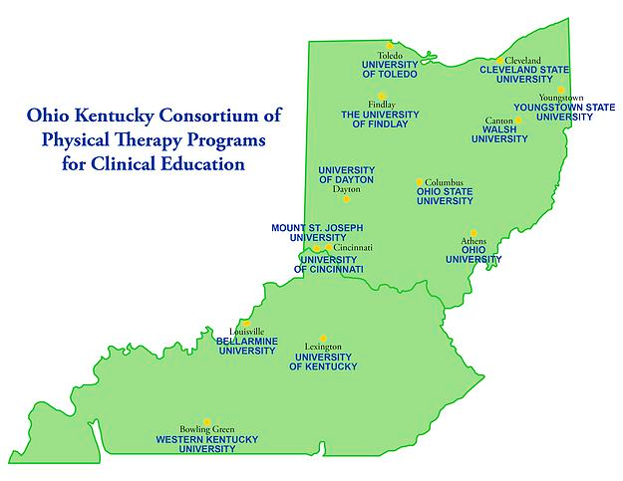
Ohio-Kentucky Consortium
Website- www.okptce.com
Browse our sections
Join our membership list -updates are only sent to the membership on a monthly basis!!
Read our monthly blog!

Slide 10
Your turn…
How would you like to receive the annual request-email, website link, snail mail, fax, or more than one way?
Does the March mailing date work for you?
What do you think are the most pressing issues in clinical education?
What does the word partnership mean to you?
What do you consider an essential part of a clinical education culture?
What input do you have regarding student readiness?

