Slide 1
Exploring Supervisory Alternatives in Clinical Education
Presented by:
Susan Hartman, PT, MBA, CCCE
Mercy St. Vincent Medical Center

Slide 2
Objectives
Identify the contemporary collaborative models of clinical education
Identify the benefits of the 2:1 model of clinical education from both the student and clinical instructor perspectives
Identify the challenges of the 2:1 model of clinical education from both the student and clinical instructor perspectives
Identify feasible solutions to the challenges imposed on students and clinical instructors within the 2:1 model of clinical education

Slide 3
Contemporary Clinical Education Models
1:1 Clinical placement model
  Considered the “normative” model to clinical education
  1 Student to 1 CI
2:1 Clinical placement model
  Is this really a “contemporary” model?
  2 Students to 1 CI
1:2 Clinical placement model
  1 Student to 2 CI’s
Notes:
1:1 How many of you have had students with the 1:1 model?
2:1 Research dates back to 1996 in the Physical Therapy Journal, assessing the 2:1 model….that was nearly 20 years ago!!! How many of you have embarked on the 2:1 model?
1:2 This is used primarily with CI’s who are part time. Between the 2 therapists, they work a full work week

Slide 4
2:1 Clinical Education Model Merits
  Students Perspective
    Offer greater learning experiences
    Greater clinical competence
    Forged clinical relationships between students
Notes:
Students feel that it optimizes peer learning, learning from the other student (not solely the CI) in a clinical setting through reflective learning. AKA: peer collaboration.
Students were reported to demonstrate more confidence in their skills when performing them in the presence of a peer (student is an equal, not superior). A less intimidating environment.
Students began to develop clinical relationships with their peer. Bouncing ideas and concepts off each other. Also, a person who is usually more available than the CI to “practice” skills on prior to working on a patient.
What does this simulate? A: The real world. As a PT/PTA, we bounce ideas, concepts, concerns off our colleagues. The students are beginning to foster this environment in their clinical!

Slide 5
2:1 Clinical Education Model Merits
  CI’s Perspective
    Increased time for clinical planning and administrative duties
    Increased productivity
    Decreased dependence on CI
Notes:
CI experienced more time to plan for individualized learning activities for each student since the CI was not directly involved in each and every patients treatment session. This allowed for more frequent formative feedback.
Research shows that with the 2:1 model, productivity initially decreases due to orientation/time to acclimate students to environment, HOWEVER, cumulatively over the 8-10 week clinical, productivity is doubled.
Students rely more on each other for clinical learning/clinical reasoning rather than the CI. NOTE: the CI continues to have an integral role in the education of clinical decision making….its just the beginning thought processes of the students are bounced off each other first!

Slide 6
Challenges of the 2:1 Model
  Students Perspective
    Not enough 1:1 time with CI
    Caseload does not support 2 students
    Hinders autonomy
    Being compared to the other student
Notes:
CI is sharing their time between 2 students, limiting the 1:1 time for formative feedback.
If the census is low, it limits “hands on” time with patients
Does not allow for student to gain “Independence”
BIAS: ________________________________

Slide 7
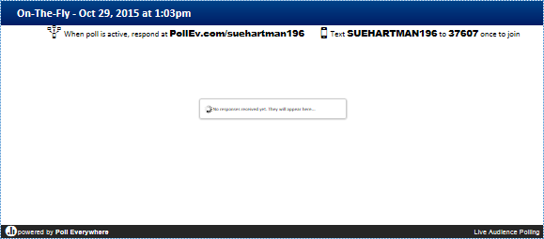
Challenges of 2:1 Model

Slide 8
Challenges of the 2:1 Model
  CI’s Perspective
    TIME
    Increased Stress
    Perceived decrease in productivity
    Perceptions of colleagues
    Paperwork

Slide 9
Embracing the 2:1 Clinical Education Model
The vital roles:
  DCE/ACCE
  CCCE
  CI
  Student
Notes:
DCE/ACCE: pairing students to optimize learning. They know the students best!
CCCE: support the CI in teaching strategies, time management. CI CREDENTIALLING COURSE!
CI:
Students: identify learning styles, commicate with CI, objectives

Slide 10
References
O’Conner A, Cahill M, McKay E: Revisiting 1:1 and 2:1 Clinical Placement Models: Student and Clinical Educator Perspectives. Australian Occupational Therapy Journal 2012; 59:276-283
Ridnflesh A, Dunfee H, Cieslak K, Eishchen S, et al.: Collaborative Model of Clinical Education in Physical and Occupational Therapy at the Mayo Clinic. Journal of Allied Health Fall 2009; 38:132-142.
Triggs-Nemshick M, Shepard K: Physical Therapy Clinical Education in a 2:1 Student-Instructor Education Model. Physical Therapy Journal 1996; 76:968-981

